Slide 1
History of virology structure and classification of viruses

Slide 2
Neolithic period around 12,000 years ago- change in human behaviour from hunter-gatherers to agricultural communities.
Lead to rapid spread of many plant viruses such as potyviruses that infect potatoes, and other fruits and vegetables, began about 6,600 years ago.
First written record of a virus infection, provided by the ancient Egyptian civilization indicated by the photos on the walls of the temples.

Slide 3
Ramesses V's preserved mummy shows that he died of smallpox at about the age of 35 in 1143 BC.
Smallpox is endemic in China by 1000BC. In response, the practice of variolation is developed.
Variolation involves inhalation of the dried crusts from smallpox lesions like snuff, or in later modifications, inoculation of the pus from a lesion into a scratch on the forearm

Slide 4
1796: Edward Jenner used cowpox to vaccinate against smallpox.
1886: Louis Pasteur experimented with rabies vaccination, using the term "virus" (Latin, poison) to describe the agent.
1886: John Buist (a Scottish pathologist) stained lymph from skin lesions of a smallpox patient and saw "elementary bodies" which he thought were the spores of micrococci.
These were in fact smallpox virus particles - just large enough to see with the light microscope.

Slide 5
1892: Dmitri Ivanovski described the first "filterable" infectious agent - tobacco mosaic virus (TMV) - smaller than any known bacteria. He showed that extracts from diseased tobacco plants can transmit disease to other plants after passage through ceramic filters fine enough to retain the smallest known bacteria.
This is generally recognized as the beginning of Virology.

Slide 6
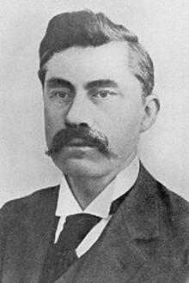
1898: Martinus Beijerinick confirmed and extended Ivanovski's work with TMV and formed the first clear concept of the virus "contagium vivum fluidum" - soluble living germ.
He was the person who developed the concept of the virus as a distinct entity. The question of whether the agent was a "living fluid" or a particle was however still open.
Martinus Beijerinick

Slide 7
1898: Freidrich Loeffler and Paul Frosch identified the first animal virus which causes foot and mouth disease (FMD)
Loeffler and Frosch were the first to prove that viruses could infect animals as well as plants.
1900: Walter Reed demonstrated that yellow fever was caused by a virus, spread by mosquitoes.

Slide 8
1908:Karl Landsteiner and Erwin Popper proved that poliomyelitis was caused by a virus. Landsteiner and Popper were the first to prove that viruses could infect humans as well as animals.
1911: Francis Peyton Rous (1879-1970) demonstrated that a virus (Rous sarcoma virus) can cause cancer in chickens (Nobel Prize, 1966) . He was the first person to show that a virus could cause cancer. It was later called Rous sarcoma virus 1 and understood to be a retrovirus. Several other cancer-causing retroviruses have since been described.

Slide 9
1915: Frederick Twort The existence of viruses that infect bacteria (bacteriophages) was first discovered.
1917: Felix d'Herelle independently discovered viruses of bacteria and coined the term bacteriophage.
1935: Wendell Stanley crystallized (TMV) and showed that it remains infectious (Nobel Prize, 1946).
Stanley's work was the first step towards describing the molecular structure of any virus and helped to further illuminate the nature of viruses.

Slide 10
1937: Max Theiler was the first to propagate yellow fever virus in chick embryos and successfully produced live attenuated vaccine - the 17D strain. (Nobel Prize, 1951).
1939(1937): Emory Ellis and Max Delbruck established the concept of the "one step virus growth cycle" essential to the understanding of virus replication (Nobel Prize, 1969). - that virus particles do not "grow" but are instead assembled from preformed components.

Slide 11
1940: Helmut Ruska used an electron microscope to take the first pictures of virus particles. Along with other physical studies of viruses, direct visualization of virions was an important advance in understanding virus structure.
1941: George Hirst demonstrated that influenza virus agglutinates red blood cells. This was the first rapid, quantitative method of measuring eukaryotic viruses.
1945: Salvador Luria (1912-1991) and Alfred Hershey(1908-1997) demonstrated that bacteriophages mutate (Nobel Prize, 1969).

Slide 12
1949: John Enders, Thomas Weller and Frederick Robbins were able to grow poliovirus in vitro using human (embryonal cells) tissue culture (Nobel Prize, 1954).
This development led to the isolation of many new viruses in tissue culture.
This work aided Jonas Salk in deriving a polio vaccine from killed polio viruses; this vaccine was shown to be effective in 1955.

Slide 13
1950: André Lwoff (1902-1994) and colleagues discovered lysogenic bacteriophage in Bacillus megaterium irradiated with ultra-violet light and coined the term prophage (Nobel Prize, 1965).
1952: Renato Dulbecco showed that animal viruses can form plaques in a similar way to bacteriophages (Nobel Prize, 1975). Dulbecco's work allowed rapid quantitation of animal viruses using plaque assays.

Slide 14
1957: The first interferon was discovered by Alick Isaacs and Jean Lindenmann
1963: Baruch Blumberg discovered hepatitis B virus (HBV) (Nobel Prize, 1976). Blumberg went on to develop the first vaccine against the HBV, considered by some to be the first vaccine against cancer because of the strong association of hepatitis B with liver cancer.

Slide 15
1970:Howard Temin (1934-1994) and David Baltimore independently discovered reverse transcriptase in retroviruses. (Nobel Prize, 1975).
The discovery of reverse transcription established a pathway for genetic information flow from RNA to DNA, refuting the so-call "central dogma" of molecular biology.

Slide 16
1972:Paul Berg created the first recombinant DNA molecules, circular SV40 DNA genomes containing l phage genes and the galactose operon of E.coli (Nobel prize, 1980). This was the beginning of recombinant DNA technology.
1979: Smallpox was officially declared to be eradicated by the World Health Organization (WHO). The last naturally occurring case of smallpox was seen in Somalia in 1977.
This was the first microbial disease ever to be completely eliminated.

Slide 17
1982: Stanley Prusiner discovered prions & demonstrates that infectious proteins cause scrapie, a fatal neurodegenerative disease of sheep (Nobel Prize, 1997).
The first cases of AIDS were reported in 1981.
1983: Luc Montaigner and Robert Gallo announced the discovery of human immunodeficiency virus (HIV), the causative agent of AIDS. In only 2-3 years since the start of the AIDS epidemic the agent responsible was identified.

Slide 18
1989: Hepatitis C virus (HCV), the source of most cases of non-A, non-B hepatitis, was identified
2003- The newly discovered Mimivirus became the largest known virus, with a diameter of 400 nm and a genome of 1.2 Mbp.
Severe acute respiratory syndrome (SARS) broke out in China and subsequently spread around the world.
2010: The United Nations Food and Agriculture Organization (FAO) declared Rinderpest virus to be globally eradicated.

Slide 19
COMMON TERMS
The term virus was coined by Pasteur, and is from the Latin word for poison.
Virus particle or virion- An infectious agent composed of nucleic acid (RNA or DNA), a protein shell (capsid) and, in some cases, a lipid envelope. Virions have full capacity for replication when a susceptible target cell is encountered.
A virion is an infectious virus particle - not all virus particles are infectious

Slide 20
Viroids are infectious agents consisting of a low molecular weight RNA that contains no protein capsid responsible for many plant diseases.
Prions- small infectious particle composed of abnormally folded protein that causes progressive neurodegenerative conditions. The term prion was coined to mean proteinaceous infectious particle [Prusiner 1982]
Satellite or Defective Viruses. Viruses which require a second virus (helper virus) for replication. Hepatitis delta virus is the major human pathogen example. It requires the presence of hepatitis B virus to complete its replication cycle.

Slide 21
Properties of Unicellular Microorganisms and Viruses
 | Growth on artificial media | Division by binary fission | Whether they have both DNA and RNA | Whether they have ribosomes | Whether they have muramic acid | Their sensitivity to antibiotics
Bacteria | Yes | Yes | Yes | Yes | Yes | Yes
Mycoplasma | Yes | Yes | Yes | Yes | No | Yes
Rickettsia | No | Yes | Yes | Yes | Yes | Yes
Chlamydia | No | Yes | Yes | Yes | No | Yes
Viruses | No | No | No | No * | No | No
* The arenavirus family (an RNA virus family) appears to package ribosomes 'accidentally'. The packaged ribosomes appear to play no role in viral protein synthesis.

Slide 22
PROPERTIES OF VIRUSES
Viruses are not cells, do not have nuclei or mitochondria or ribosomes or other cellular components.
They lack metabolic activity (i.e., metabolically inert) and essential constituents required for independent growth and multiplication.
Viruses are obligate intracellular parasites.

Slide 23
Viruses do not grow.
Because viruses are non-motile, they are entirely dependent on external physical factors for chance movement and spread to infect other susceptible cells.
Some viruses can induce latent infections.
DNA genome of some viruses could get integrated in the host genome-prophage
Some viruses could lead to transformation of the host cells.

Slide 24
Virus size
Small in size
Smallest of viruses are about 20 nm in diameter
Average human cells are 10–30 μm (microns) in diameter- 100 to 1000 times larger than the viruses that are infecting them.
Some viruses are >100 nm. Eg Poxviruses can approach 400 nm in length, and filoviruses, are only 80 nm in diameter but extend into long threads that can reach lengths of over 1000 nm.
Recently discovered –megavirus- 400 nm in diameter, and pandoraviruses have an elliptical or ovoid structure approaching 1000 nm in length.

Slide 25
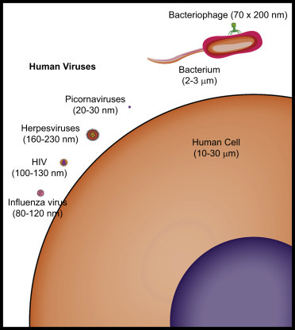

Slide 26
VIRUS STRUCTURE
Viruses have:
a nucleic acid genome (RNA or DNA)
a protective protein coat (called the capsid)
The nucleic acid genome plus the protective protein coat = nucleocapsid

Slide 27
Viral capsids - icosahedral or helical or complex symmetry
Viruses may have an envelope made of lipid derived from the host cell membranes.
Virus without envelope-naked virus or Non-enveloped virus
In some enveloped viruses the glycoprotein projects out in the form of spike called peplomers

Slide 28
Enveloped viruses
The envelope is a lipid membrane that is derived from one of the cell’s membranes, most often the plasma membrane,
Endoplasmic reticulum, Golgi complex, or nuclear membrane.
Matrix proteins function to connect the envelope to the capsid inside.

Slide 29
Enveloped viruses do not necessarily have to kill their host cell in order to be released, since they can bud out of the cell hence some budding viruses can set up persistent infections.
Enveloped viruses are readily infectious only if the envelope is intact (since the viral attachment proteins which recognize the host cell receptors are in the viral envelope). This means that agents that damage the envelope, such as alcohols and detergents, reduce infectivity.

Slide 30
Virus attachment protein embedded in outer-most layer of virus (in the capsid, in the case of a naked virus, or the envelope, in the case of an enveloped virus).
The virus attachment protein is the viral protein that facilitates the docking of the virus to the plasma membrane of the host cell, the first step in gaining entry into a cell.

Slide 31
The Capsid (coat) protein is the basic unit of structure made up of protein subunits called capsomeres. Subunits called protomers aggregate to form capsomeres.
The number of capsomeres in a capsid varies from virus to virus.
Functions
Protect viral nucleic acid
Interact specifically with the viral nucleic acid for packaging
Interact with host receptors for entry to cell
Allow for release of nucleic acid upon entry into new cell

Slide 32
VIRION NUCLEOCAPSID STRUCTURES
Icosahedral symmetry
Helical symmetry
Complex
Symmetry refers to the way in which capsomere units are arranged in viral capsid.

Slide 33
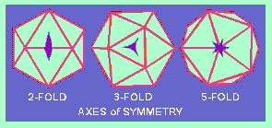
An ICOSAHEDRON is composed of 20 faces, each an equilateral triangle, 12 vertices and 30 edges, and because of the axes of rotational symmetry is said to have
5:3:2 symmetry. Mostly appear spherical in shape.
Axes of Symmetry : Six 5-fold axes of symmetry passing through the vertices, ten 3-fold axes extending through each face and fifteen 2-fold axes passing through the edges of an icosahedron.

Slide 34
Capsomers at the 12 corners have a 5-fold symmetry and interact with 5 neighboring capsomers, and are thus known as pentons or pentamer.
Larger viruses contain more capsomers; extra capsomers are arranged in a regular array on the faces of the icosahedrons. They have six neighbors and are called hexons or hexamers
The size of such an icosahedron depends on the size and number of capsomers, there will always be 12 pentons, but the number of hexons may increase.

Slide 35
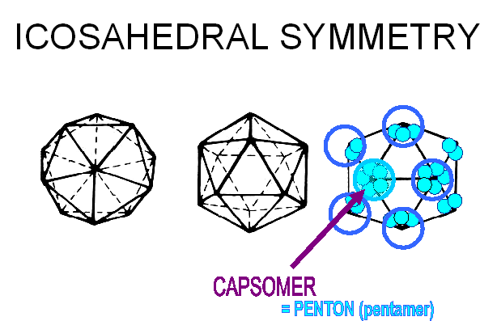
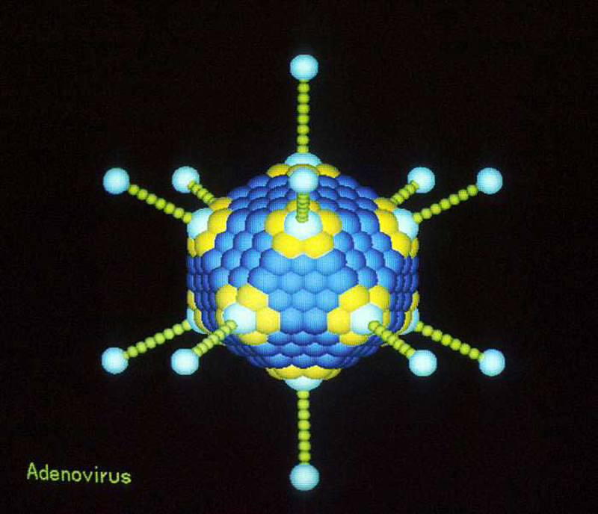
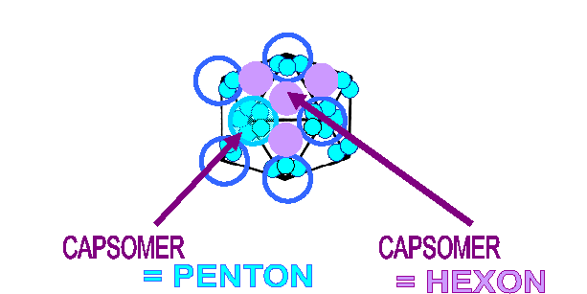

Slide 36
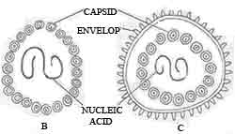
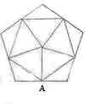
Icosahedral
B. Naked Icosahedral
C. Enveloped Icosahedral

Slide 37
Helical symmetry
The helix is a spiral shape that curves cylindrically around an axis.
The viral nucleic acid coils into a helical shape and the capsid proteins wind around the inside or outside of the nucleic acid, forming a long tube or rod-like structure.
One type of capsid protein (only 1 gene required hence small size genomes) present so simple in structure.
The capsid length will be the size of the coiled nucleic acid (helical structure can continue indefinitely)
First non-enveloped helical symmetry plant virus - TMV
In enveloped, helically symmetrical viruses (e.g. influenza virus, rabies virus), the capsid is more flexible (and longer)
All helical animal viruses are enveloped and all are RNA viruses.

Slide 38
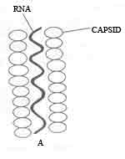
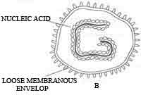
Naked Virus
(TMV)
Enveloped helical virus
(Influenza virus)

Slide 39
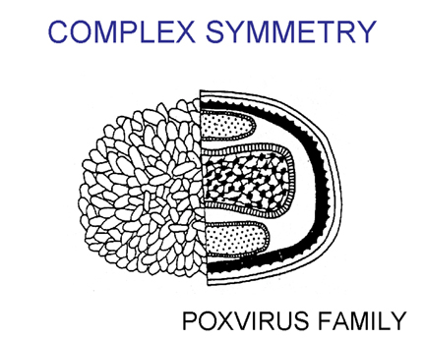
Complex symmetry
Symmetry that does not strictly conform to a simple helical or icosahedral shape.
Example: Poxviruses and many bacteriophages
They may posses tails and icosahedral head (e.g., many bacteriophages) or
have complex, multilayered walls surrounding the nucleic acid (e.g., poxviruses such as vaccinia).

Slide 40
FIVE BASIC STRUCTURAL FORMS OF VIRUSES IN NATURE
Naked icosahedral e.g. poliovirus, adenovirus, hepatitis A virus
Naked helical e.g. tobacco mosaic virus. So far no human viruses with this structure are known
Enveloped icosahedral e.g. herpes virus, yellow fever virus, rubella virus
Enveloped helical e.g. rabies virus, influenza virus, parainfluenza virus, mumps virus, measles virus
Complex e.g. poxvirus

Slide 41
CLASSIFICATION OF VIRUSES
The process of naming viruses and placing them into a taxonomic system
1966 the International Committee for the Nomenclature of Viruses formed.
Changed to the International Committee for the Taxonomy of Viruses (ICTV) in 1973
Viruses are only classified using order, family, genus, and species

Slide 42
The general taxonomic structure is as follows:
Order (-virales)
Family (-viridae)
Subfamily (-virinae)
Genus (''-virus'')
Species (''-virus'')

Slide 43
Primary characteristics used in classification
VIRAL CLASSIFICATION
Nucleic acid | RNA or DNA
 | single-stranded or double-stranded
 | non-segmented or segmented
 | linear or circular
 | if genome is single stranded RNA, can it function as mRNA?
 | whether genome is diploid (such as in retroviruses)
Virion structure | symmetry (icosahedral, helical, complex)
 | enveloped or non enveloped
 | number of capsomers

Slide 44
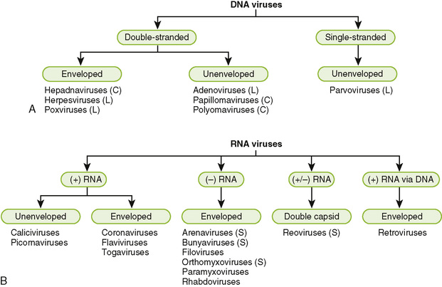
Classification of virus on the basis of nucleic acid

Slide 45
BALTIMORE CLASSIFICATION
Nobel Prize-winning biologist David Baltimore in the early 1970s.
The central theme - all viruses must generate positive strand mRNAs from their genomes, in order to produce proteins and replicate themselves.
The precise mechanisms whereby this is achieved differ for each virus family.
Either the genes are stored in the 5'→3' direction (positive or + polarity), analogous to the direction in which genes are represented in mRNA in cells, or the genes are stored in the opposite, 3'→5' direction (negative or - polarity).

Slide 46
In other words: + or - polarity of RNA:
  "+“ sense is able to serve as mRNA.
  "-" sense is the complement of “+”, must function as template to make a complementary strand of + RNA before any translation can occur.
Ambisense viruses contain at least one ambisense RNA segment, i.e. an RNA that is in part of positive and in part of negative polarity.

Slide 47
7 classes or groups:
• dsDNA viruses
• ssDNA viruses
• dsRNA viruses
• (+)-sense ssRNA viruses
• (-)-sense ssRNA viruses
• RNA reverse transcribing viruses
• DNA reverse transcribing viruses

Slide 48
Group I (Adenoviruses; Herpesviruses; Poxviruses, etc) viruses contain double-stranded DNA (dsDNA) as their genome. Their mRNA is produced by transcription in much the same way as with cellular DNA.
Group II (Parvoviruses) viruses have single-stranded DNA (ssDNA) as their genome. They convert their single-stranded genomes into a dsDNA intermediate before transcription to mRNA can occur.

Slide 49
Group III (Reoviruses; Birnaviruses) dsRNA genome. The strands separate, and one of them is used as a template for the generation of mRNA using the RNA-dependent RNA polymerase encoded by the virus.
Group IV (Picornaviruses; Togaviruses, etc) viruses have ssRNA as their genome with a positive polarity. Intermediates of dsRNA, called replicative intermediates, are made in the process of copying the genomic RNA. Multiple, full-length RNA strands of negative polarity (complementary to the positive-stranded genomic RNA) are formed from these intermediates, which may then serve as templates for the production of RNA with positive polarity, including both full-length genomic RNA and shorter viral mRNAs.

Slide 50
Group V (Orthomyxoviruses, Rhabdoviruses, etc) viruses contain ssRNA genomes with a negative polarity, meaning that their sequence is complementary to the mRNA.
As with Group IV viruses, dsRNA intermediates are used to make copies of the genome and produce mRNA. In this case, the negative-stranded genome can be converted directly to mRNA. Additionally, full-length positive RNA strands are made to serve as templates for the production of the negative-stranded genome.

Slide 51
Group VI (Retroviruses)viruses have diploid (two copies) ssRNA genomes that must be converted, using the enzyme reverse transcriptase, to dsDNA; the dsDNA is then transported to the nucleus of the host cell and inserted into the host genome. Then, mRNA can be produced by transcription of the viral DNA that was integrated into the host genome.
Group VII (Hepadnaviruses) viruses have partial dsDNA genomes (longer negative-sense strand and a shorter positive-sense strand of variable length) and make ssRNA intermediates that act as mRNA, but are also converted back into dsDNA genomes by reverse transcriptase, necessary for genome replication.

Slide 52
